Slide 1
CA3 Individual Household Electric Power Consumption Data Set
AKASH KUMAR NADIPALLI
12007137
ROLL NO:36

Slide 2
Data Set Information:
This archive measurements gathered in a house between December 2006 and November 2010 (47 months).
Global_active_power,Global_reactive_power,Voltage,Global_intensity,Sub_metering_1, Sub_metering_2,Sub_metering_3 represents the active energy consumed every minute (in watt hour) in the household by electrical equipment not measured in sub-meterings 1, 2 and 3.
The dataset contains some missing values in the measurements.

Slide 3
Attribute Information:
date: Date in format dd/mm/yyyy
time: time in format hh:mm:ss
global_active_power: household global minute-averaged active power (in kilowatt)
global_reactive_power: household global minute-averaged reactive power (in kilowatt)
voltage: minute-averaged voltage (in volt)
global_intensity: household global minute-averaged current intensity (in ampere)
sub_metering_1: energy sub-metering No. 1 (in watt-hour of active energy). It corresponds to the kitchen, containing mainly a dishwasher, an oven and a microwave (hot plates are not electric but gas powered).
sub_metering_2: energy sub-metering No. 2 (in watt-hour of active energy). It corresponds to the laundry room, containing a washing-machine, a tumble-drier, a refrigerator and a light.
sub_metering_3: energy sub-metering No. 3 (in watt-hour of active energy). It corresponds to an electric water-heater and an air-conditioner.

Slide 4
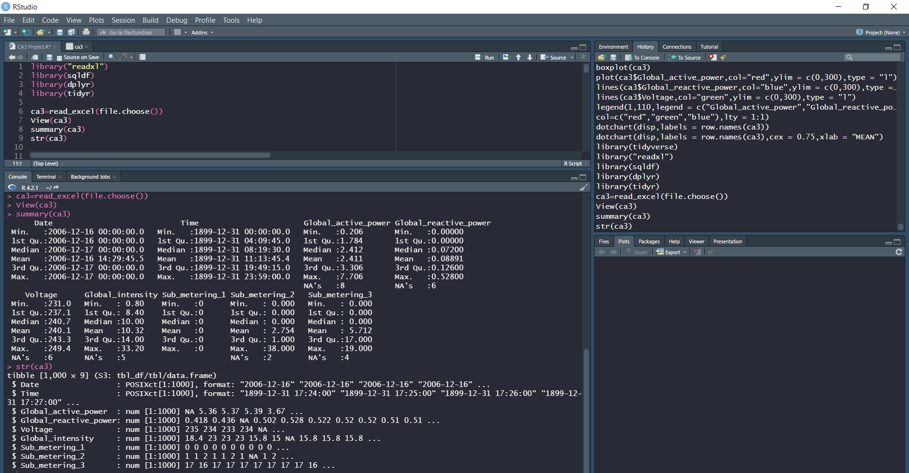
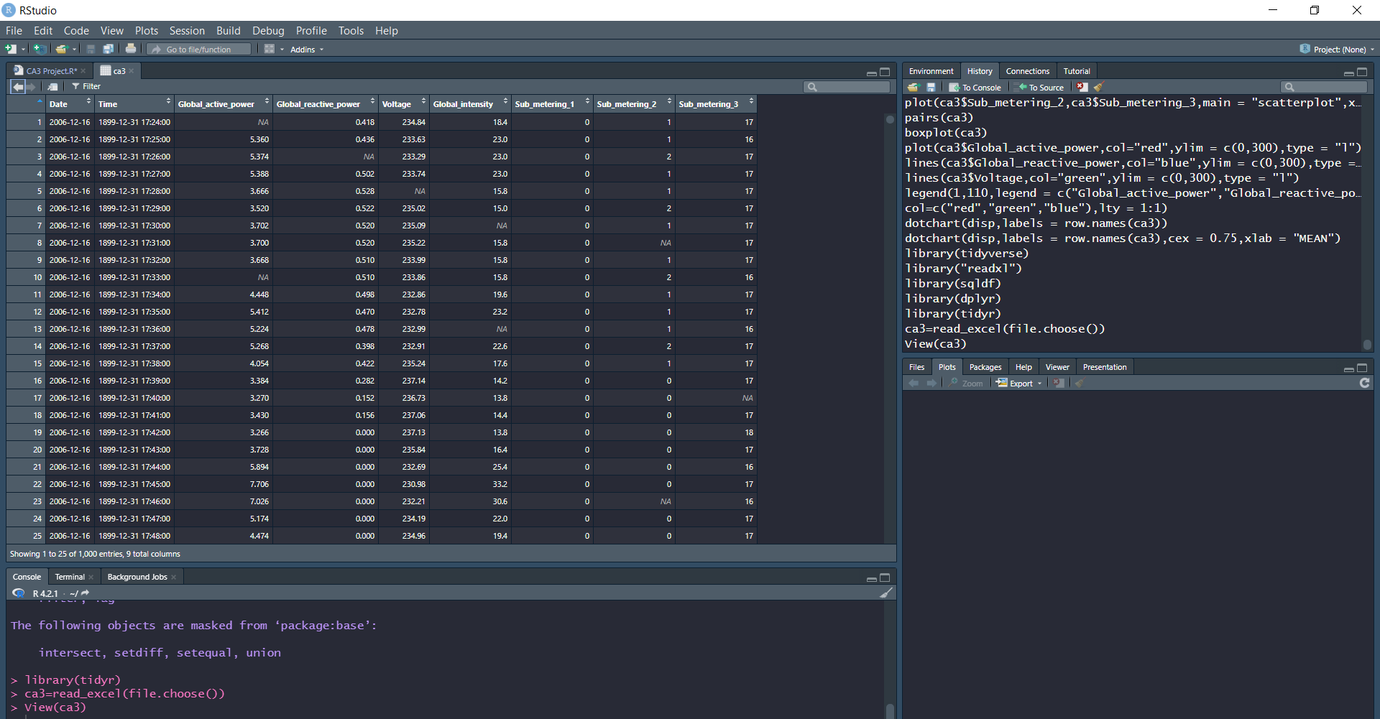
For reading data:
library("readxl")
library(sqldf)
library(dplyr)
library(tidyr)
ca3=read_excel(file.choose())
View(ca3)
summary(ca3)
str(ca3)

Slide 5
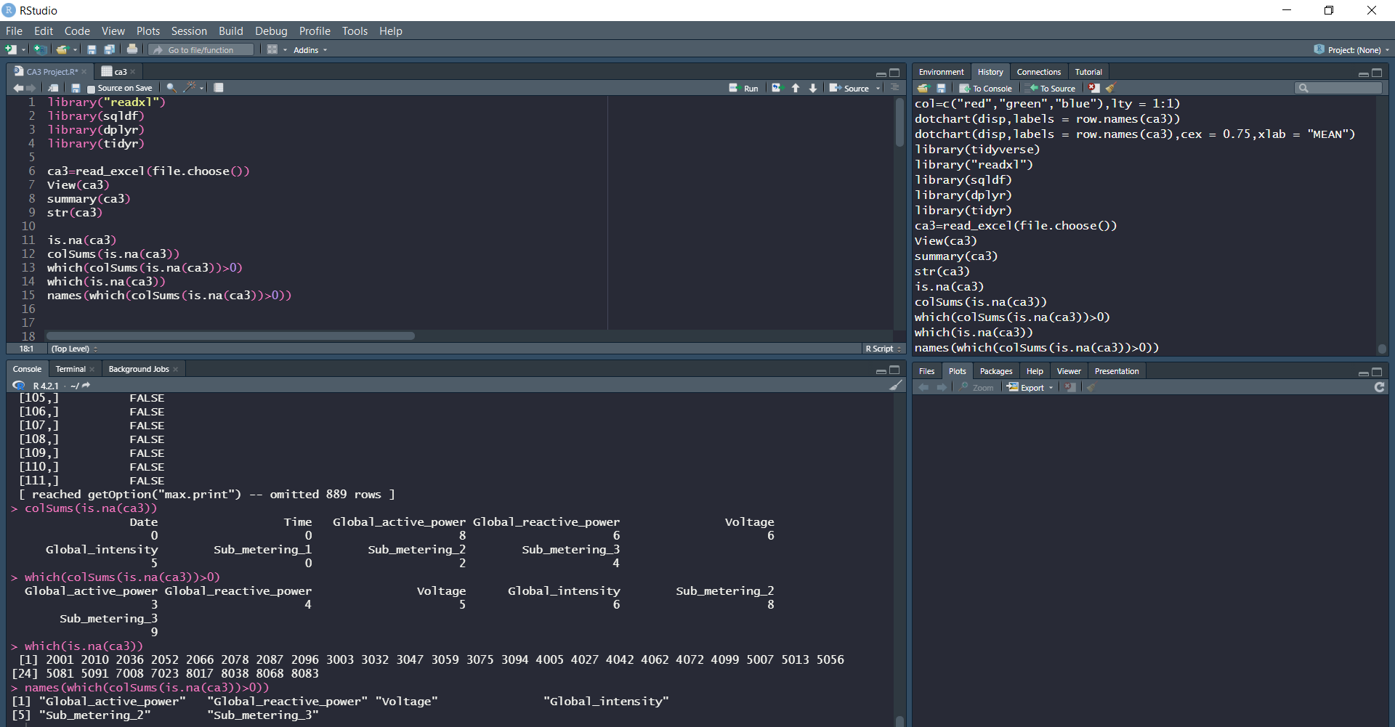
For na values
is.na(ca3)
colSums(is.na(ca3))
which(colSums(is.na(ca3))>0)
which(is.na(ca3))
names(which(colSums(is.na(ca3))>0))

Slide 6
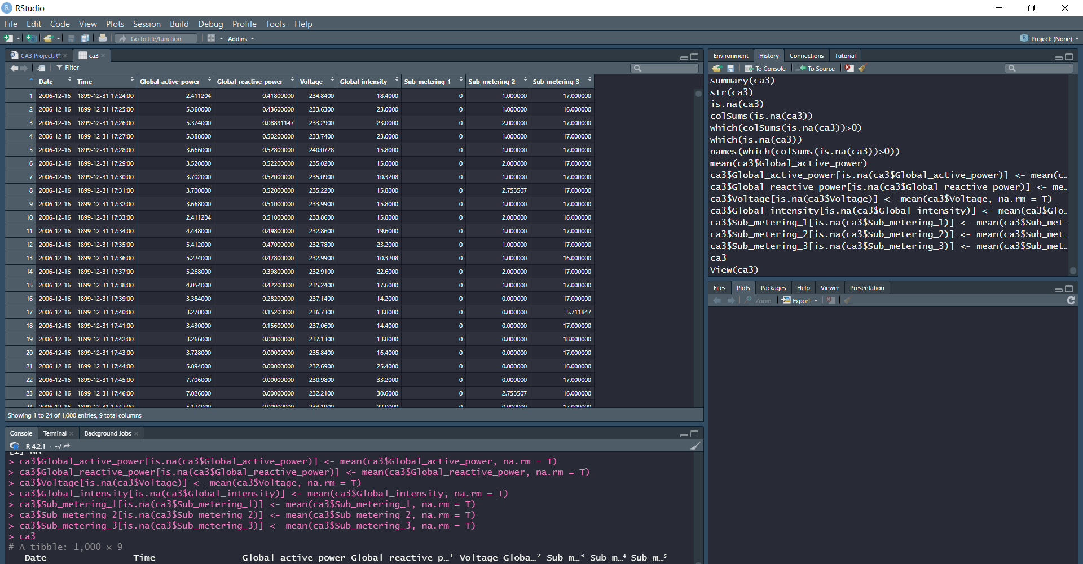
For imputate data
ca3$Global_active_power[is.na(ca3$Global_active_power)] <- mean(ca3$Global_active_power, na.rm = T)
ca3$Global_reactive_power[is.na(ca3$Global_reactive_power)] <- mean(ca3$Global_reactive_power, na.rm = T)
ca3$Voltage[is.na(ca3$Voltage)] <- mean(ca3$Voltage, na.rm = T)
ca3$Global_intensity[is.na(ca3$Global_intensity)] <- mean(ca3$Global_intensity, na.rm = T)
ca3$Sub_metering_1[is.na(ca3$Sub_metering_1)] <- mean(ca3$Sub_metering_1, na.rm = T)
ca3$Sub_metering_2[is.na(ca3$Sub_metering_2)] <- mean(ca3$Sub_metering_2, na.rm = T)
ca3$Sub_metering_3[is.na(ca3$Sub_metering_3)] <- mean(ca3$Sub_metering_3, na.rm = T)

Slide 7
For mean and median
d1=sample_n(ca3,1000)
View(d1)
d2=summarise(ca3,Global_active_power_mean=mean(Global_active_power),Global_active_power_median=median(Global_active_power), Global_reactive_power_mean=mean(Global_reactive_power),Global_reactive_power_median=median(Global_reactive_power),
Voltage_mean=mean(Voltage),Voltage_median=median(Voltage),
Global_intensity_mean=mean(Global_intensity),Global_intensity_median=median(Global_intensity),
Sub_metering_1_mean=mean(Sub_metering_1),Sub_metering_1_median=median(Sub_metering_1),
Sub_metering_2_mean=mean(Sub_metering_2),Sub_metering_2_median=median(Sub_metering_2),
Sub_metering_3_mean=mean(Sub_metering_3),Sub_metering_3_median=median(Sub_metering_3))
View(d2)
d3=ca3%>%rowwise()%>%mutate(Max=max(Global_active_power,Global_reactive_power,Voltage,Global_intensity,Sub_metering_1,Sub_metering_2,Sub_metering_3))%>%select(Global_active_power,Global_reactive_power,Voltage,Global_intensity,Sub_metering_1,Sub_metering_2,Sub_metering_3,Max)
View(d3)

Slide 8
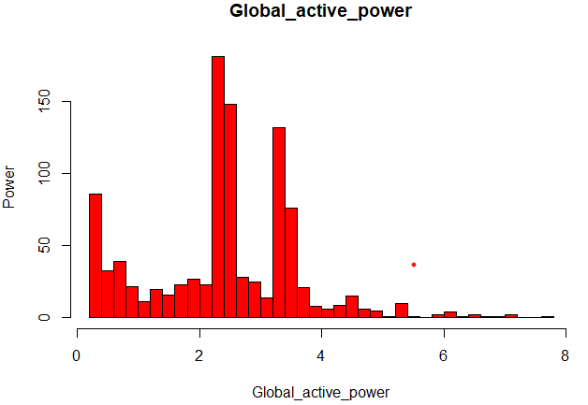
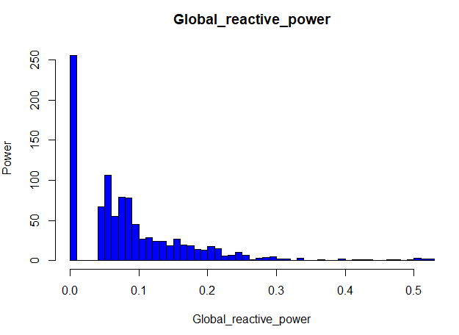
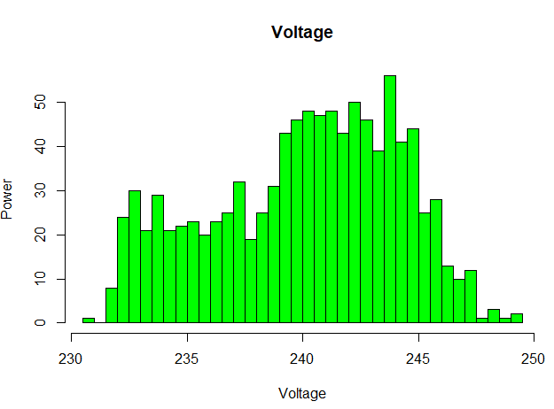
For histogram
hist(ca3$Global_active_power,breaks=50,col = "red",
main = "Global_active_power",xlab = "Global_active_power",ylab = "Power")
hist(ca3$Global_reactive_power,breaks=50,col = "blue",
main = "Global_reactive_power",xlab = "Global_reactive_power",ylab = "Power")
hist(ca3$Voltage,breaks=50,col = "green",
main = "Voltage",xlab = "Voltage",ylab = "Power")
hist(ca3$Global_intensity,breaks=50,col = "violet",
main = "Global_intensity",xlab = "Global_intensity",ylab = "Power")
hist(ca3$Sub_metering_1,breaks=1,col = "orange",
main = "Sub_metering_1",xlab = "Sub_metering_1",ylab = "Power")
hist(ca3$Sub_metering_2,breaks=50,col = "green",
main = "Sub_metering_2",xlab = "Sub_metering_2",ylab = "Power")
hist(ca3$Sub_metering_3,breaks=50,col = "pink",
main = "Sub_metering_3",xlab = "Sub_metering_3",ylab = "Power")

Slide 9
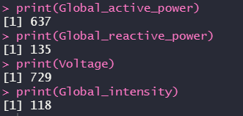
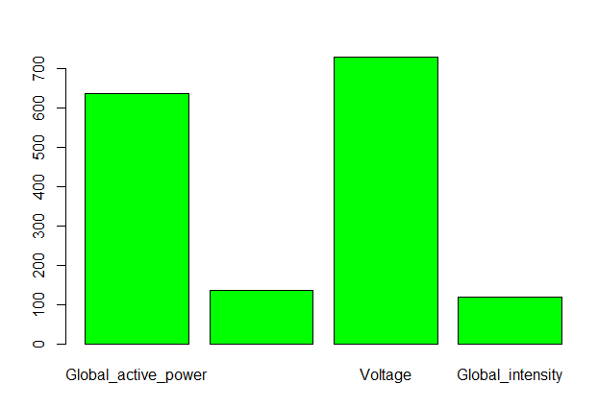
For barplot
Global_active_power=as.numeric(sqldf("select COUNT(DISTINCT(Global_active_power)) from ca3 "))
Global_reactive_power=as.numeric(sqldf("select COUNT(DISTINCT(Global_reactive_power)) from ca3"))
Voltage=as.numeric(sqldf("select COUNT(DISTINCT(Voltage)) from ca3"))
Global_intensity=as.numeric(sqldf("select COUNT(DISTINCT(Global_intensity)) from ca3"))
print(Global_active_power)
print(Global_reactive_power)
print(Voltage)
print(Global_intensity)
barplot(c(Global_active_power,Global_reactive_power,Voltage,Global_intensity),names.arg = c("Global_active_power","Global_reactive_power","Voltage","Global_intensity") ,col = "green")

Slide 10
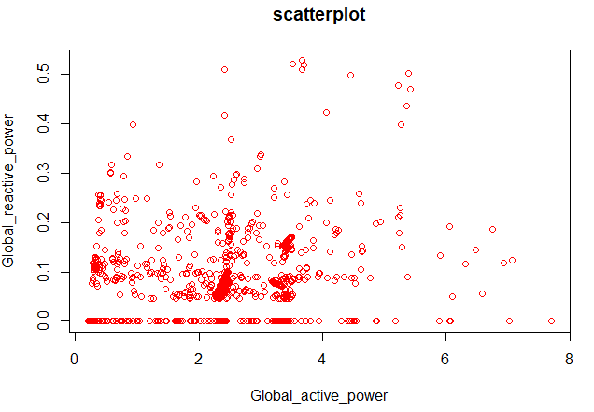
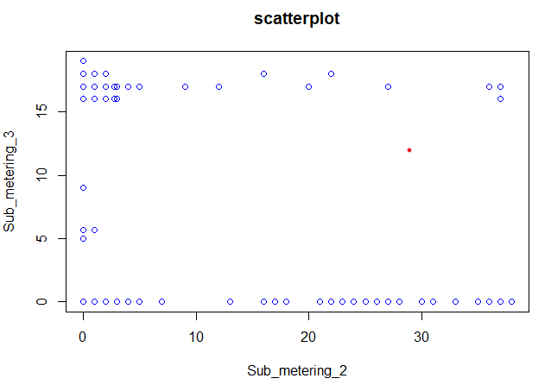
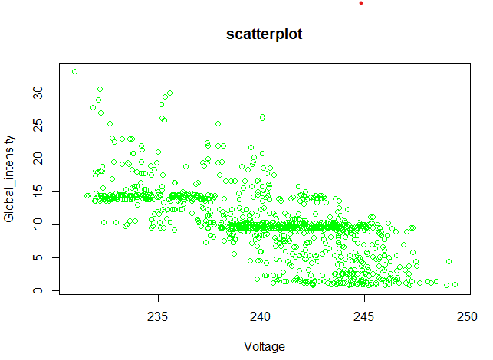
For scatterplot
plot(ca3$Global_active_power,ca3$Global_reactive_power,main = "scatterplot",xlab = "Global_active_power",ylab = "Global_reactive_power",col = "red")
plot(ca3$Voltage,ca3$Global_intensity,main = "scatterplot",xlab = "Voltage",ylab = "Global_intensity",col = "green")
plot(ca3$Sub_metering_2,ca3$Sub_metering_3,main = "scatterplot",xlab = "Sub_metering_2",ylab = "Sub_metering_3",col = "blue")

Slide 11
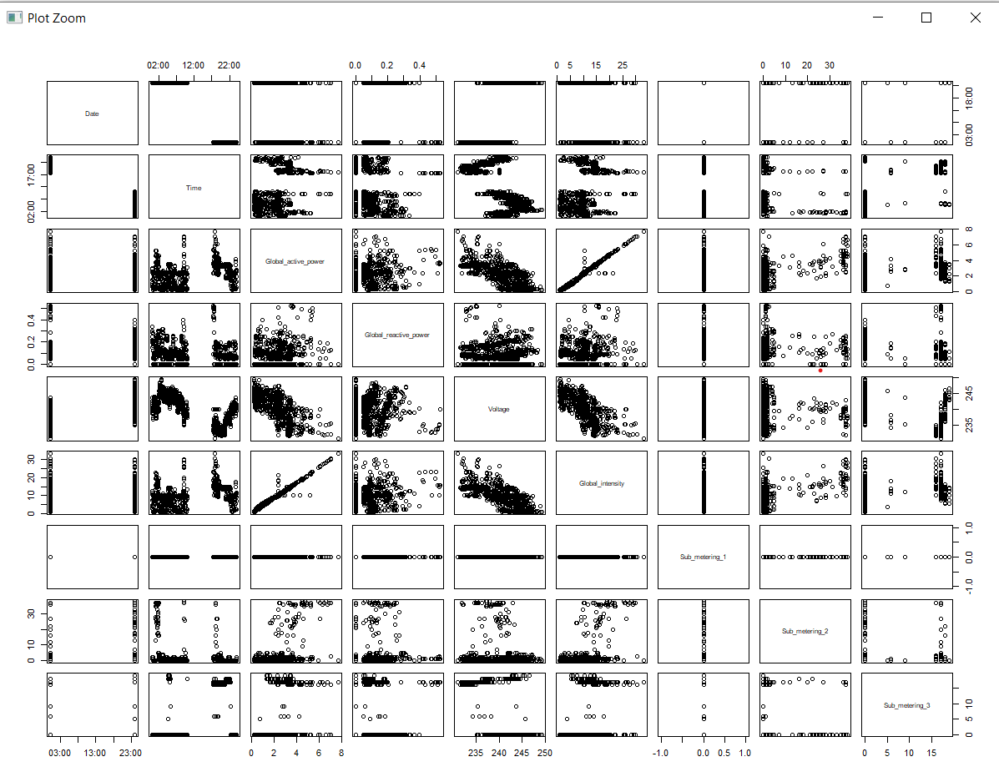
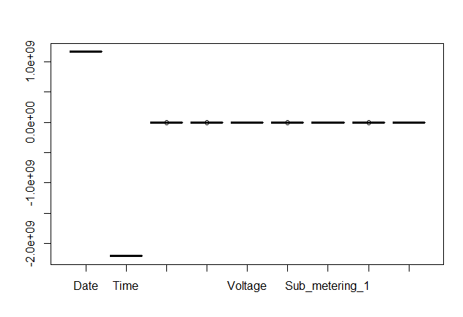
pairs(ca3)
boxplot(ca3)

Slide 12
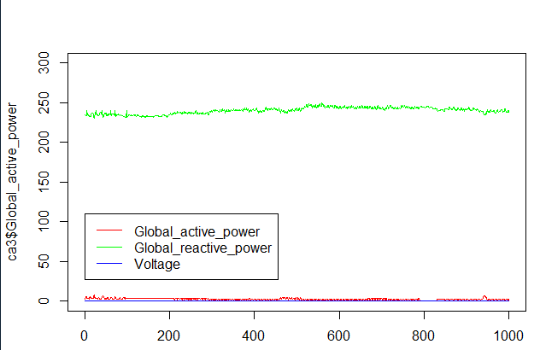
plot(ca3$Global_active_power,col="red",ylim = c(0,300),type = "l")
lines(ca3$Global_reactive_power,col="blue",ylim = c(0,300),type = "l")
lines(ca3$Voltage,col="green",ylim = c(0,300),type = "l")
legend(1,110,legend = c("Global_active_power","Global_reactive_power","Voltage"),
col=c("red","green","blue"),lty = 1:1)

Slide 13
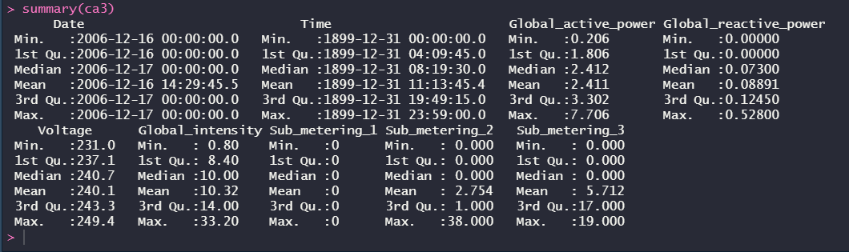
summary(ca3)

Slide 14
THANK YOU

